Slide 1
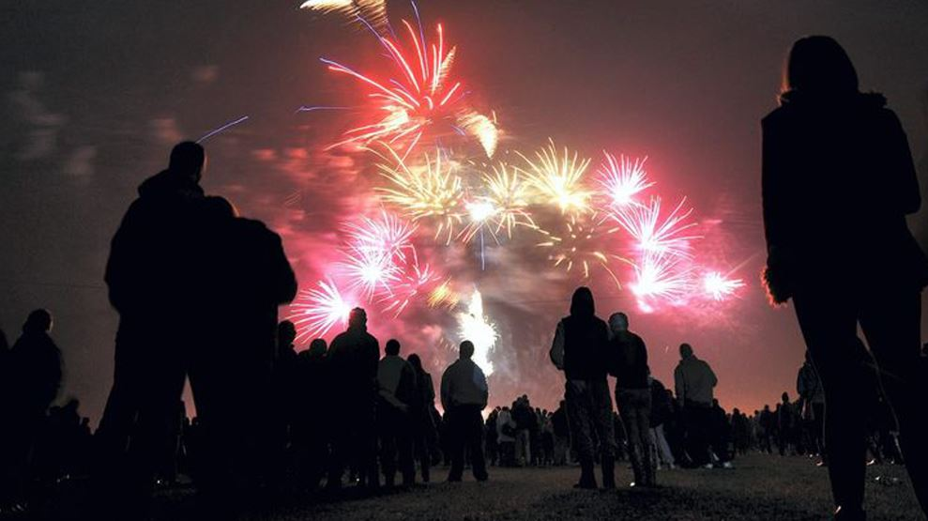
Fireworks
©West Yorkshire Police
Notes:
CHECK – Climate for Learning
Have I spoken with the class teacher first? (Input Agreement checklist)?
Have I introduced myself?
Have I explained the ground rules? (Join in; hands up to answer; listen when I/someone else is speaking.)
Today I am going to talk to you about how to stay safe at Halloween and on Bonfire Night

Slide 2
Video
Youtube video
©West Yorkshire Police
Notes:
Discuss how Covid-19 regulations are affecting fireworks displays this year and the additional safety measures around social distancing.

Slide 3
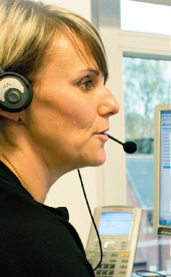
Did you know…?
Halloween and Bonfire Night week are one of the
busiest times of the year for the police.
In West Yorkshire;
1,573 people rang 999 on 31st October (Halloween)
in just 24 hours (that’s one day).
©West Yorkshire Police
Notes:
Read out. That’s more than one phone call every minute of the day and night!
Why do you think Halloween and Bonfire night is the busiest time of year? Flick back to previous slide if children are struggling for ideas or prompt with what might happen with fire/fireworks/trick or treating?
Does anyone know what this lady is doing? Take ideas but explain she is a call handler. She answers the telephone when you ring the police. Her headset is part of the phone. Do you think she is on her own or are there lots of call handlers with her? Clarify perceptions. She, and lots and lots of other people in a big room answer the calls.
Why do people usually ring 999?
Take some ideas and explain some if children aren’t sure. (Try to use the children’s names as you learn them. It will mean a lot to them!)
At Halloween and Bonfire Night, with the hundreds of extra calls, it can take seconds longer to find out which calls really need urgent help, and those seconds can put people lives in danger.
For this reason, it’s really important that we know how to be safe, and to help keep each other safe.
We don’t want anyone here, or any of your families or friends needing to call the police.
So how can we stay safe at Halloween and Bonfire Night?
(next slide)

Slide 4
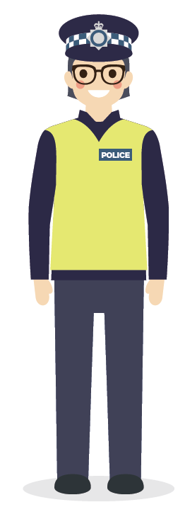
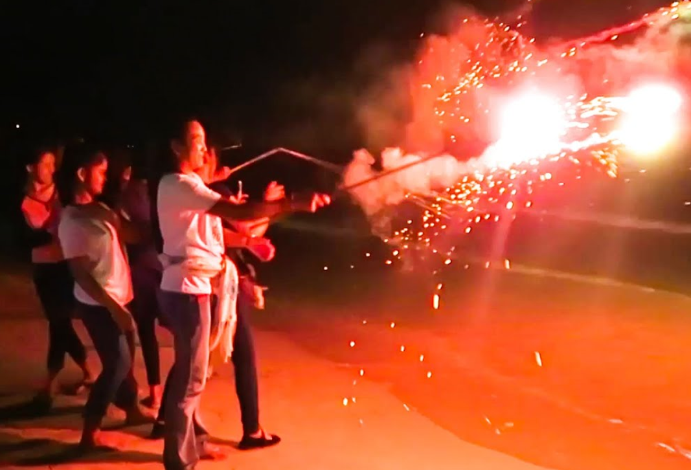
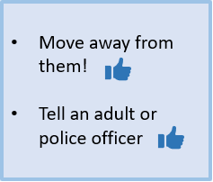
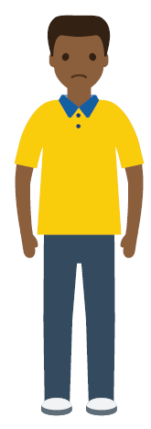
Fireworks
What would you do if you saw someone doing something dangerous or wrong?
?
©West Yorkshire Police
Notes:
Move away to stay safe, not get in trouble, and not be associated with people doing the wrong thing.
Tell someone so they can be looked after and kept safe

Slide 5
Fireworks
Fireworks Code
Adults should only buy fireworks over the counter from respected stores.
Only an adult should handle and light fireworks.
Fireworks should be kept in a closed box away from sparks.
An adult should read and follow the instructions for lighting fireworks carefully.
Always stand well back (8m is best).
Never go back to a lit firework.
Never put fireworks in your pocket.
Never throw fireworks.
Fireworks are loud, spectacular, beautiful and exciting!
In the UK we have the annual Bonfire Night fireworks and other celebrations through the year.
Can you tell me other times in the year fireworks are used?
Fireworks can also be very dangerous if we forget to follow the Fireworks Code.
©West Yorkshire Police
Notes:
Read through the slide
Explain sparklers as well

Slide 6
Dangers of Fireworks
Most commonly injured body parts
Hands, Wrists, Fingers (36%)
Head, Ears, Face (22%)
Eyes (16%)
Legs (14%)
Waist (7%)
Arms (5%)
How does this information help us think about our own safety?
Every year over 4,000 people are injured due to misuse of fireworks and bonfires.
Firework rockets can reach speeds of 150mph when they are set off.
Animals can become extremely stressed and behave out of character. Loud bangs can also be painful and distressing for pets as their hearing is more acute than humans.
Sparklers are five times hotter than cooking oil!
©West Yorkshire Police
Notes:
Read through the slide

Slide 7
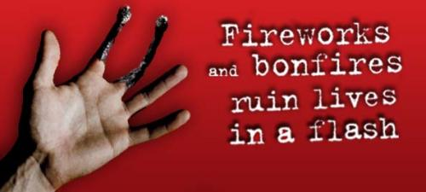
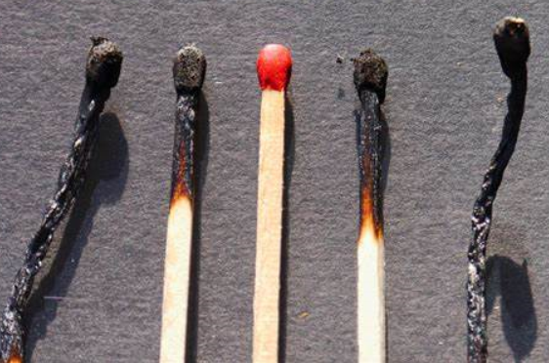
Dangers of Fireworks
?
Why did this poster use burnt matches to represent fingers?
©West Yorkshire Police
Notes:
Read through the slide

Slide 8
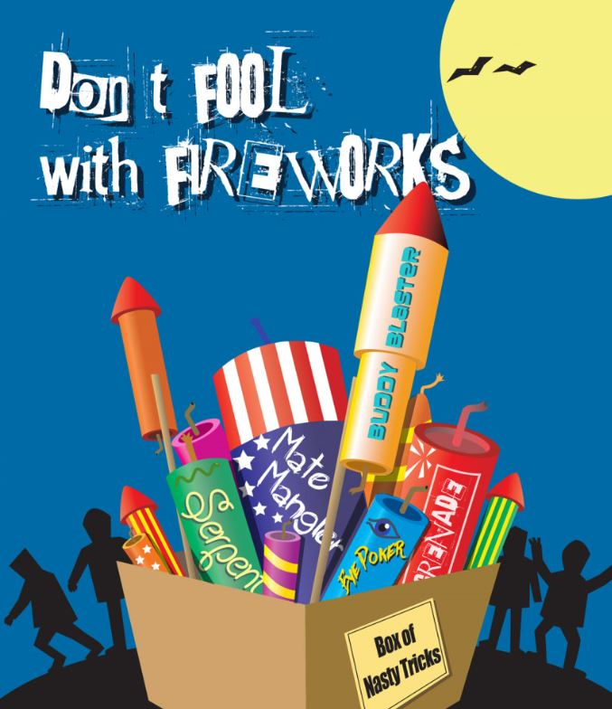
Fireworks and the law
It is illegal:
To let off any fireworks in a public place - this carries a fine of up to £5000. We may also issue an £80 Fixed Penalty Notice.
To set off fireworks between 11pm and 7am (Bonfire night extended until 12 midnight).
For a member of the public to possess a “display” style firework (Category 4 fireworks, can only be used by professionals).
To cause unnecessary suffering to animals with fireworks. Maximum penalty £5000 and/or six months in prison.
To sell bangers, mini rockets, fireworks that fly erratically (Squibs, helicopters etc), aerial shells and maroons.
To store fireworks for private use for more than 14 days
To sell fireworks to anyone under 18 years of age. Maximum penalty - £5000 and/or six months in prison.
©West Yorkshire Police
Notes:
Read through the slide

Slide 9
Remember
An organised display is the safest way to enjoy fireworks.
Fireworks are noisy (which can upset very young or elderly people as well as pets). They can cause damage and they can cause serious injuries if not used properly.
It is an offence to buy fireworks by anyone under the age of 18. You can be fined or imprisoned for buying or using fireworks illegally.
It is an offence to let fireworks off between 11pm and 7am except on 5th November when the cut off is midnight and on Diwali, New Year’s Eve and Chinese New Year when the cut off is 1am. It is also an offence to set off fireworks in a public place.
Keep bonfires small and manageable and build them away from houses, garages, sheds, fences, overhead cables, trees, bushes and vehicles.
Never use flammable liquids – paraffin or petrol – to light the fire.
Only children over the age of five are allowed to use sparklers and should be supervised by an adult at all times.
©West Yorkshire Police
Notes:
Read through the slide

Slide 10
Me and my friends in the police will be out making sure you, your friends and family are being safe on Halloween and Bonfire Night.
Say, ‘hello’ if you see me.
©West Yorkshire Police
Notes:
Read through. End building positive relationships!

Slide 11
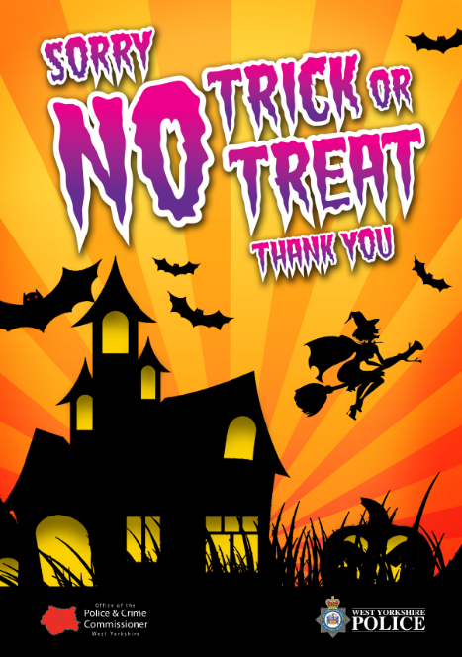
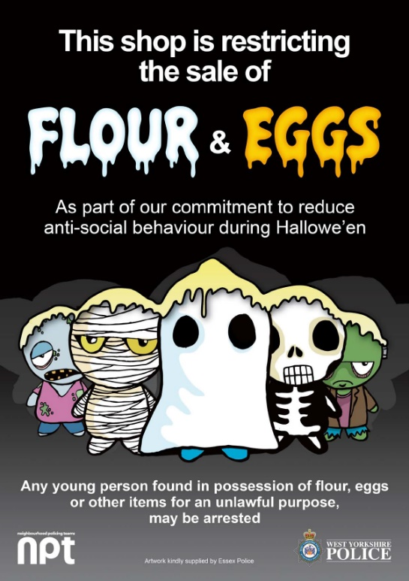
Resources and Links
West Yorkshire Police Bonfire Safety
https://www.westyorkshire.police.uk/advice/personal-safety/bonfire-firework-halloween-safety/bonfire-firework-safety/bonfire-firework-safety
West Yorkshire Police Halloween Safety Advice
https://www.westyorkshire.police.uk/advice/personal-safety/bonfire-firework-halloween-safety/halloween-safety-advice/halloween-safety-advice
©West Yorkshire Police
Notes:
Resources and Links

