Slide 1
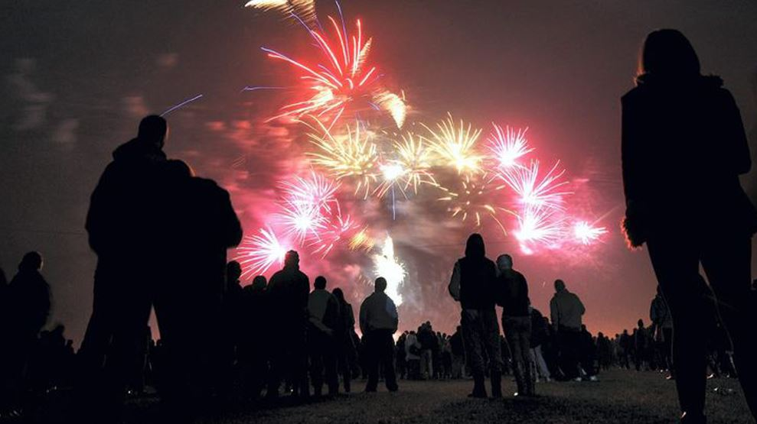
Halloween and Bonfire Night
©West Yorkshire Police
Notes:
CHECK – Climate for Learning
Have I spoken with the class teacher first? (Input Agreement checklist)?
Have I introduced myself?
Have I explained the ground rules? (Join in; hands up to answer; listen when I/someone else is speaking.)
Today I am going to talk to you about how to stay safe at Halloween and on Bonfire Night

Slide 2
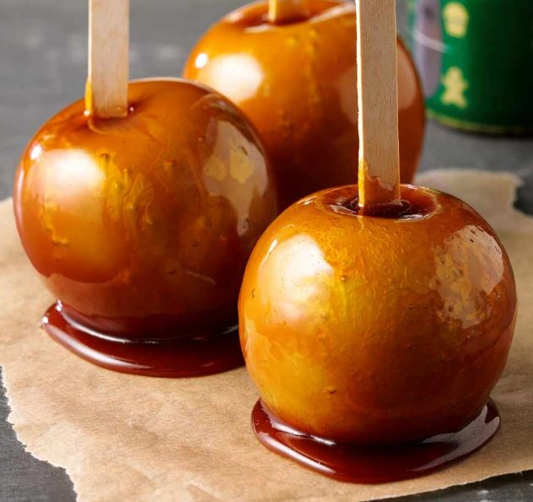
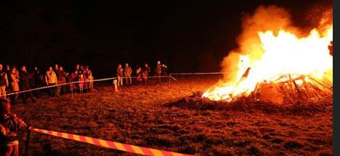
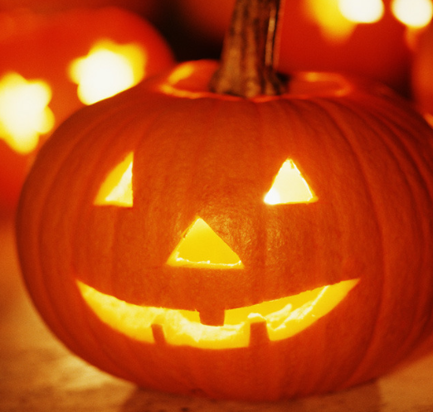
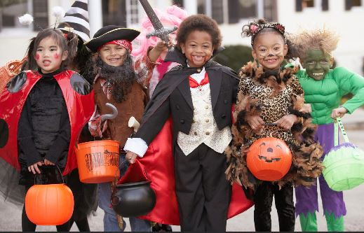
©West Yorkshire Police
Notes:
Is anyone doing anything special for Halloween or Bonfire Night?
Has anyone ever been to a Bonfire or fireworks display before?
Listen in turn to a few comments. Take the opportunity to learn some children’s names and build relations through being interested in what they are doing.

Slide 3
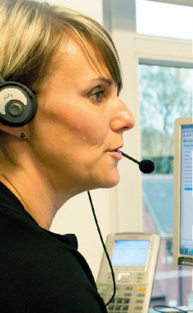
Did you know…?
Halloween and Bonfire Night week are one of the
busiest times of the year for the police.
In West Yorkshire;
1,573 people rang 999 on 31st October (Halloween)
in just 24 hours (that’s one day).
©West Yorkshire Police
Notes:
Read out. That’s more than one phone call every minute of the day and night!
Why do you think Halloween and Bonfire night is the busiest time of year? Flick back to previous slide if children are struggling for ideas or prompt with what might happen with fire/fireworks/trick or treating?
Does anyone know what this lady is doing? Take ideas but explain she is a call handler. She answers the telephone when you ring the police. Her headset is part of the phone. Do you think she is on her own or are there lots of call handlers with her? Clarify perceptions. She, and lots and lots of other people in a big room answer the calls.
Why do people usually ring 999?
Take some ideas and explain some if children aren’t sure. (Try to use the children’s names as you learn them. It will mean a lot to them!)
At Halloween and Bonfire Night, with the hundreds of extra calls, it can take seconds longer to find out which calls really need urgent help, and those seconds can put people lives in danger.
For this reason, it’s really important that we know how to be safe, and to help keep each other safe.
We don’t want anyone here, or any of your families or friends needing to call the police.
So how can we stay safe at Halloween and Bonfire Night?
(next slide)

Slide 4
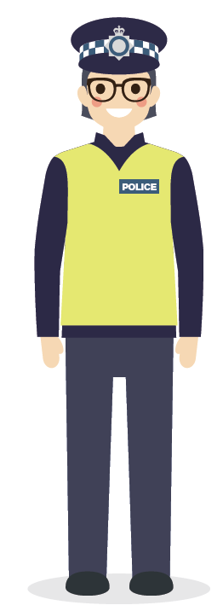
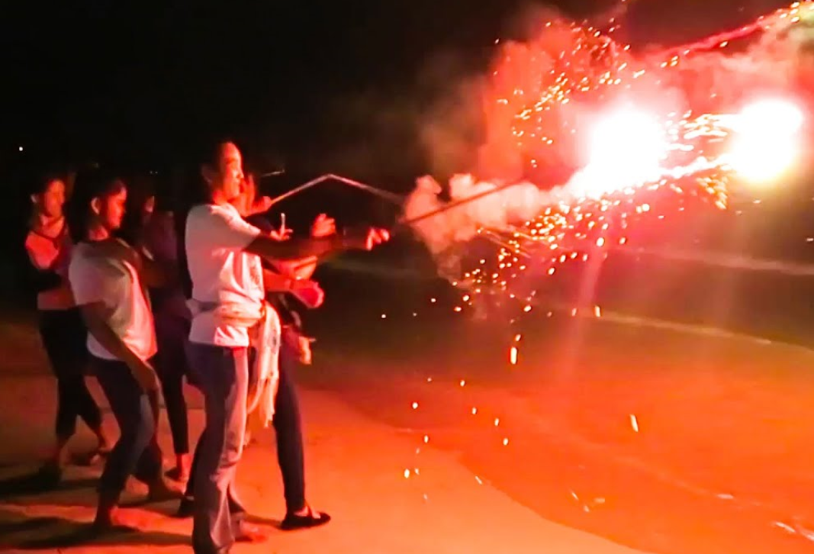
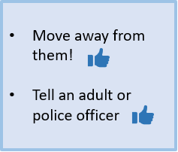
Halloween and Bonfire Night
What would you do if you saw someone doing something dangerous or wrong?
?
©West Yorkshire Police
Notes:
Move away to stay safe, not get in trouble, and not be associated with people doing the wrong thing.
Tell someone so they can be looked after and kept safe

Slide 5
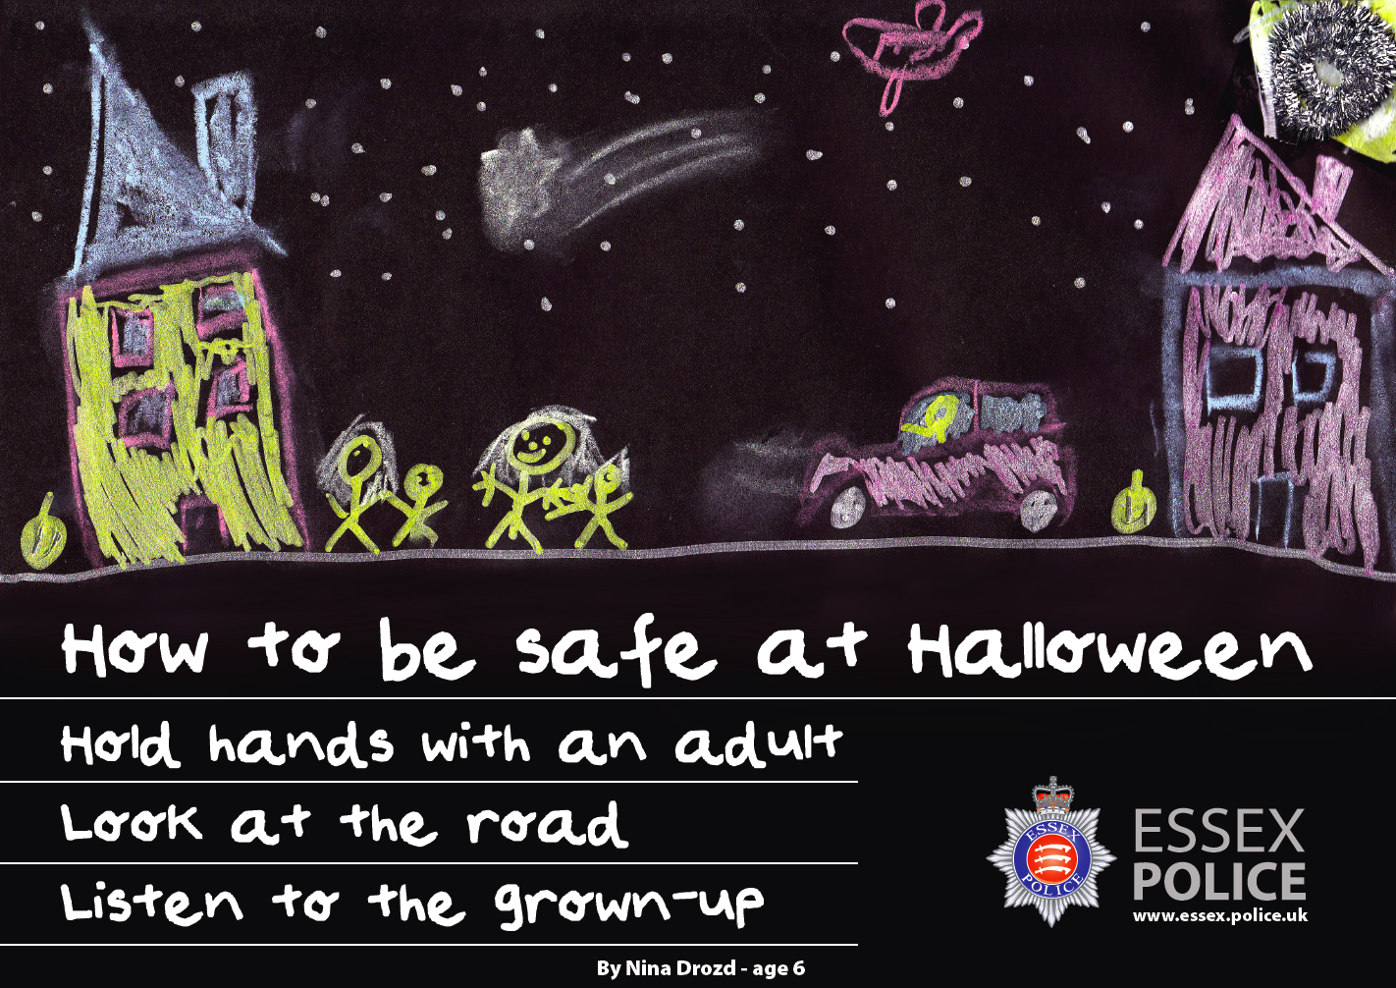
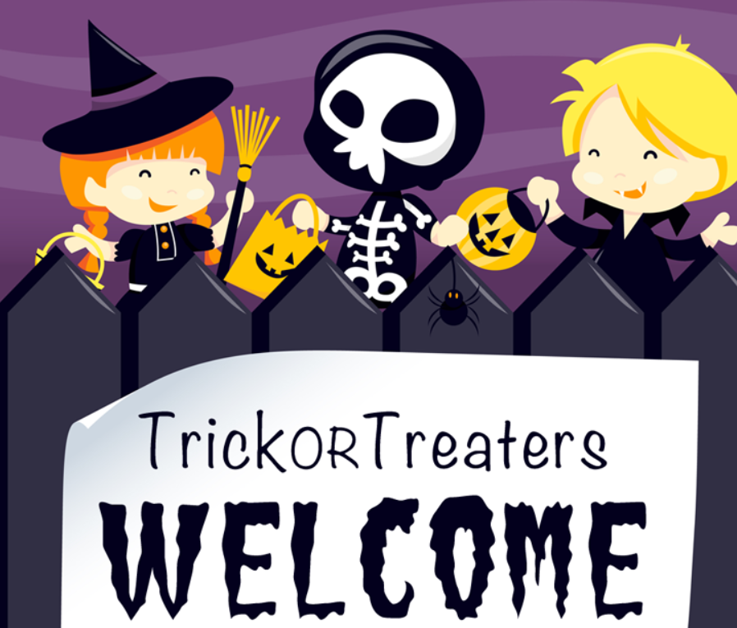
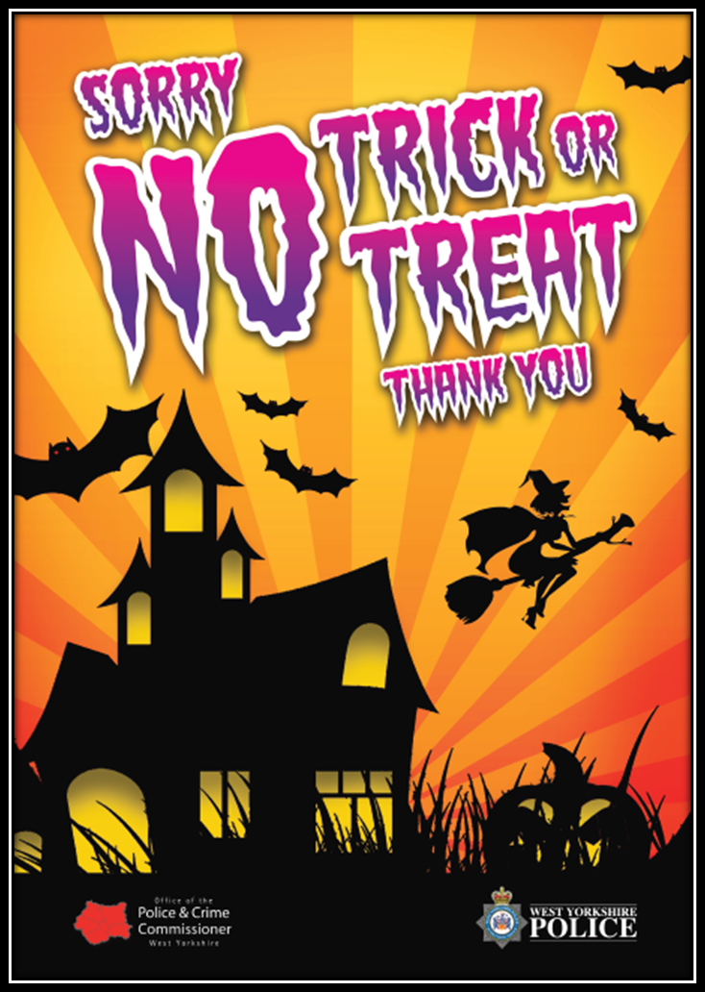
How else can we stay safe at Halloween?
Where you know the people
Where the house is decorated and welcomes trick or treaters
Which houses should you go to?
If you don’t know the people
If they have a sign saying NO
Which houses shouldn’t you go to?
©West Yorkshire Police
Notes:
Read through the slide as the animations appear.
Discus the last point – why might people have a sign saying, ‘no’?
Elderly; baby asleep, shift workers; loud dog/pets.

Slide 6
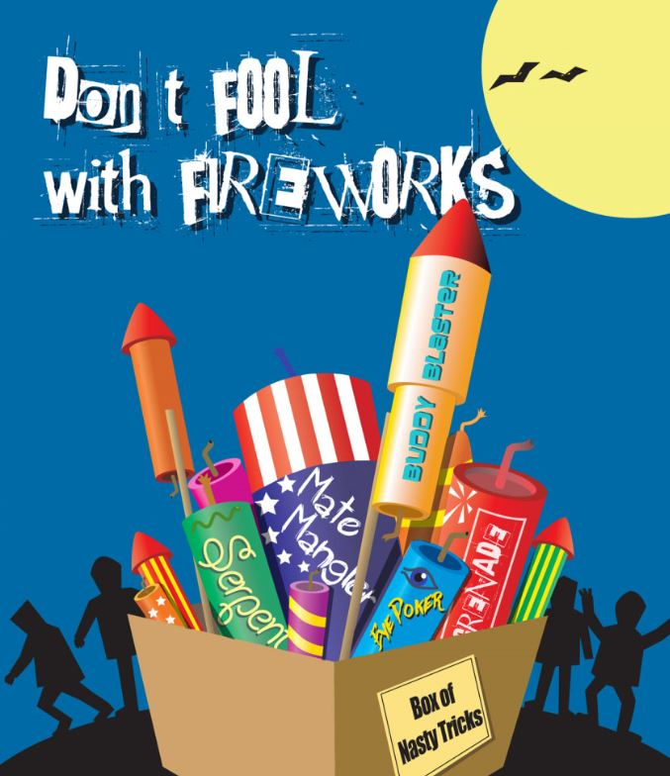
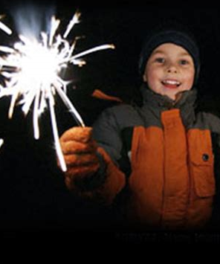
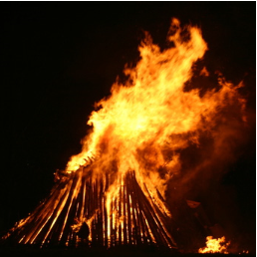
How can we stay safe on Bonfire Night?
Wear gloves
Use one sparkler at a time and hold at arms length
Never pick up a used sparkler – it might still be hot
How do we use sparklers safely?
Stand well back
Don’t touch fireworks or fire, even with a stick
How do we stay safe around fire?
How might our pets feel? What should we do?
Keep pets safe indoors
©West Yorkshire Police
Notes:
Talk through sparkler safety explaining reasons why. You can put used sparklers in a bucket of water to make sure they cool down. Mention the big fireworks poster. Leave fireworks to the adult!
Talk about care for pets, and how fireworks and loud bangs scare them. This helps little children empathise with the feelings of others. Who else might be scared? Babies?

Slide 7
Me and my friends in the police will be out making sure you, your friends and family are being safe on Bonfire Night.
Say, ‘hello’ if you see me.
©West Yorkshire Police
Notes:
Read through. End building positive relationships!

Slide 8
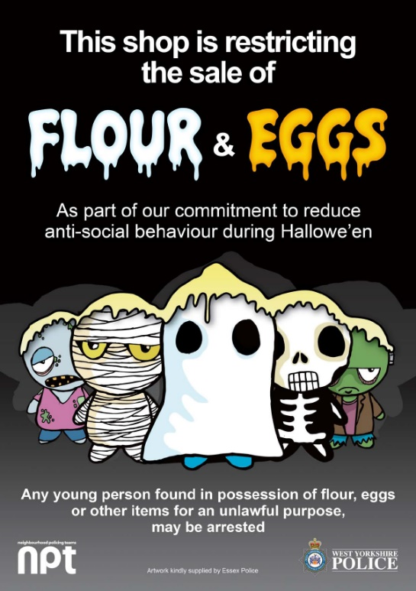
Resources and Links
West Yorkshire Police Bonfire Safety
https://www.westyorkshire.police.uk/advice/personal-safety/bonfire-firework-halloween-safety/bonfire-firework-safety/bonfire-firework-safety
West Yorkshire Police Halloween Safety Advice
https://www.westyorkshire.police.uk/advice/personal-safety/bonfire-firework-halloween-safety/halloween-safety-advice/halloween-safety-advice
©West Yorkshire Police
Notes:
Resources and Links

