Slide 1
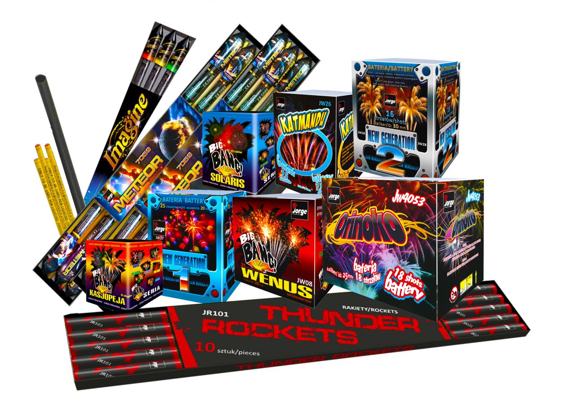
Fireworks The Law

Slide 2
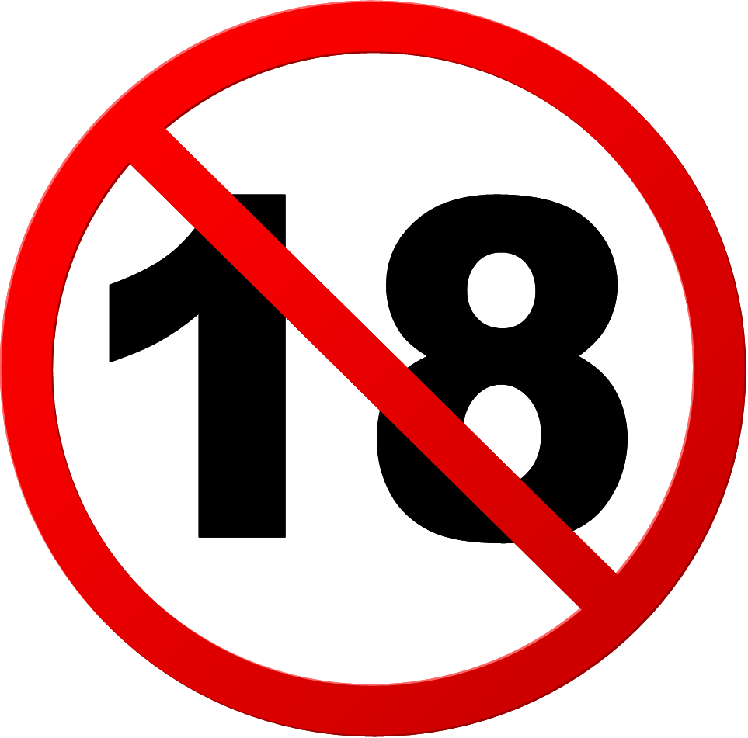
It is illegal to sell fireworks to any person under the age of 18.

Slide 3
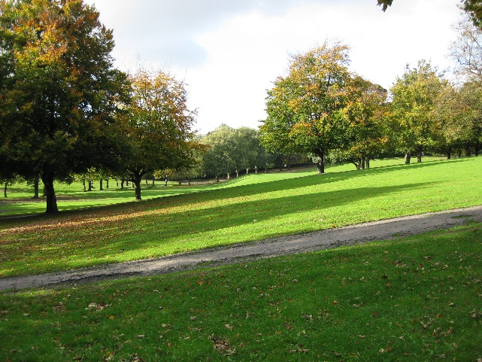
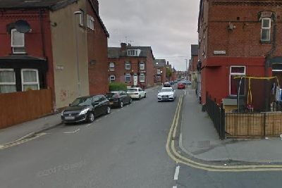
It is illegal for any person under the age of 18 to possess a firework in a public place.
Public place includes:
Parks
Roads
Car Parks

Slide 4
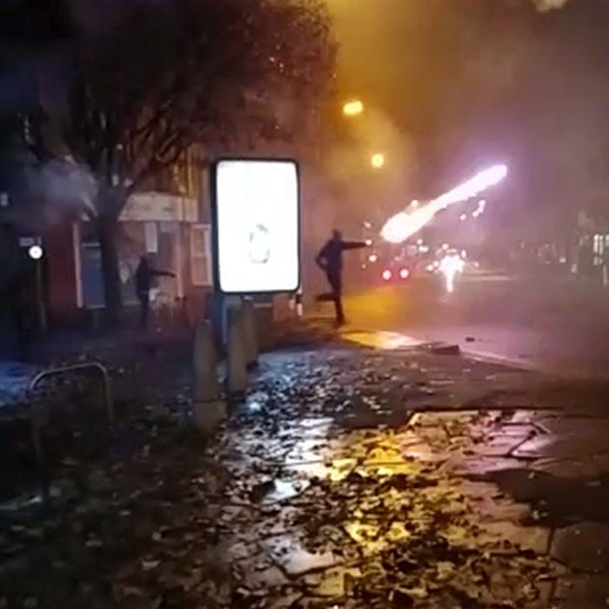
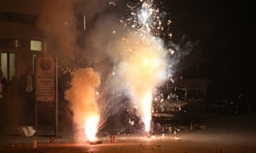
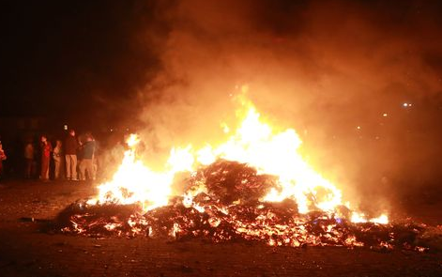
It is illegal to set off or throw a Firework or make a bonfire in a Street or Public Place.

Slide 5
If you throw fireworks, bricks, stones or any other objects towards people, buildings or vehicles. You could be arrested for:
Criminal Damage
Assault
Public Order/Nuisance
Offences

Slide 6
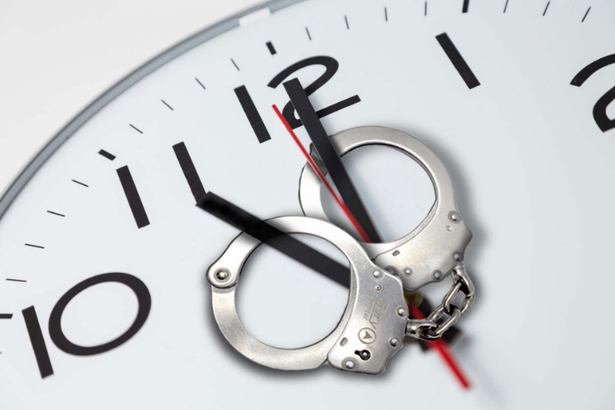
Firework Curfews
Fireworks must not be used between 11pm and 7am.
For special celebrations such as New Years Eve, Chinese New Year, Diwali, Fireworks must not be used after 1am.

Slide 7
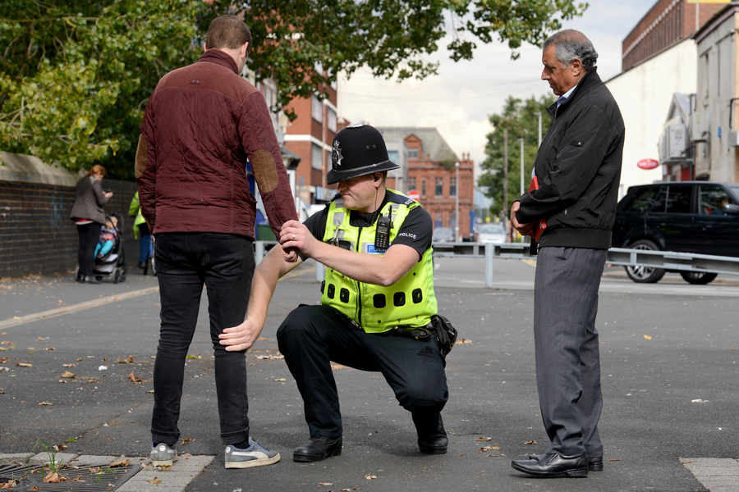
The Police CAN search you for fireworks.

Slide 8
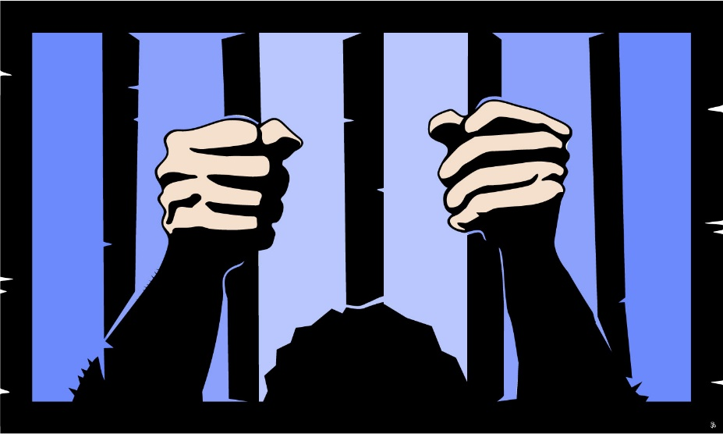
If you BREAK the LAW you may be arrested and could be:
Imprisoned
This could affect future education and/or
employment opportunities.

